Slide 1
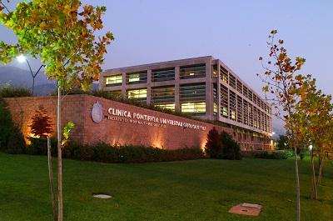
lesões epiteliais conjuntivais
Dr. Pablo Zoroquiain PhD.
Patologista e citopatologista ocular
Departamento de Patologia, Faculdade de Medicina,
Pontifícia Universidade Católica do Chile.

Slide 2
Differential diagnosis of leucocoria
Benign
Premalignant/malignant
Pterygium/pinguecula
Squamous papilloma
Xerosis
Upper limbic keratoconjunctivitis
Keratoconjunctivitis sicca
Points of Bitot:
Deficiency of vitamin A
Conjunctival intraepithelial neoplasia
Squamous cell carcinoma
Adenosquamous cell carcinoma (Mucoepidermoid carcinoma)
Lymphoma
Fibrohistiocytic lesions

Slide 3
Differential diagnosis of leucocoria
Benign
Premalignant/malignant
Pterygium/pinguecula
Squamous papilloma
Xerosis
Upper limbic keratoconjunctivitis
Keratoconjunctivitis sicca
Points of Bitot:
Deficiency of vitamin A
Conjunctival intraepithelial neoplasia
Squamous cell carcinoma
Adenosquamous cell carcinoma (Mucoepidermoid carcinoma)
Lymphoma
Fibrohistiocytic lesions

Slide 4
Differential diagnosis of leucocoria
Benign
Premalignant/malignant
Pterygium/pinguecula
Squamous papilloma
Xerosis
Upper limbic keratoconjunctivitis
Keratoconjunctivitis sicca
Points of Bitot:
Deficiency of vitamin A
Conjunctival intraepithelial neoplasia
Squamous carcinoma
Adenosquamous carcinoma (Mucoepidermoid carcinoma)
Lymphoma
Fibrohistiocytic lesions

Slide 5
Pterygium
Frequent degenerative lesion
Similar to pinguecula but with corneal infiltration
Associated with UV

Slide 6
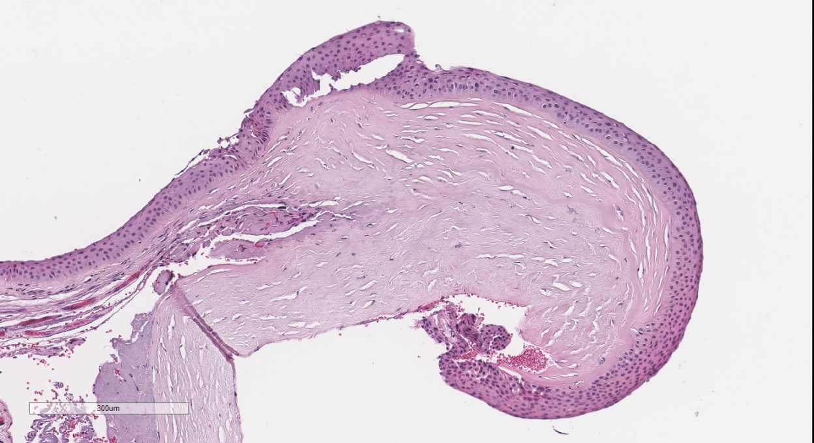
Pterygium
Fibrovascular connective tissue that migrates to the cornea
It may masked a neoplastic process.

Slide 7
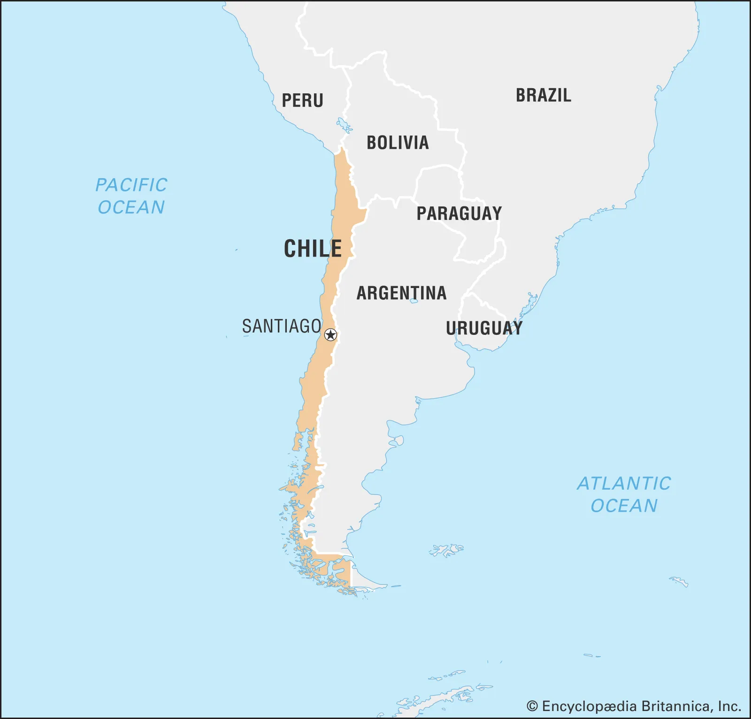
North 3,4% incidence of OSSN (N=54)
South 0% incidence of OSSN (N=55)

Slide 8
Differential diagnosis
Benign
Dysplastic/malignant
Pterygium/pinguecula
Squamous papilloma
Xerosis
Upper limbic keratoconjunctivitis
Keratoconjunctivitis sicca
Points of Bitot:
Deficiency of vitamin A
Conjunctival intraepithelial neoplasia
Squamous carcinoma
Adenosquamous carcinoma (Mucoepidermoid carcinoma)
Lymphoma
Fibrohistiocytic lesions

Slide 9
Conjunctival squamous cell papilloma
Benign lesion
Adults and children
Extralimbal localization (highest association with HPV 6 and 11)
Paediatric and young adults
Limbal location
Higher risk of associated OSSN
Macroscopic classification:
Pediculated
Sesile
Inverted

Slide 10
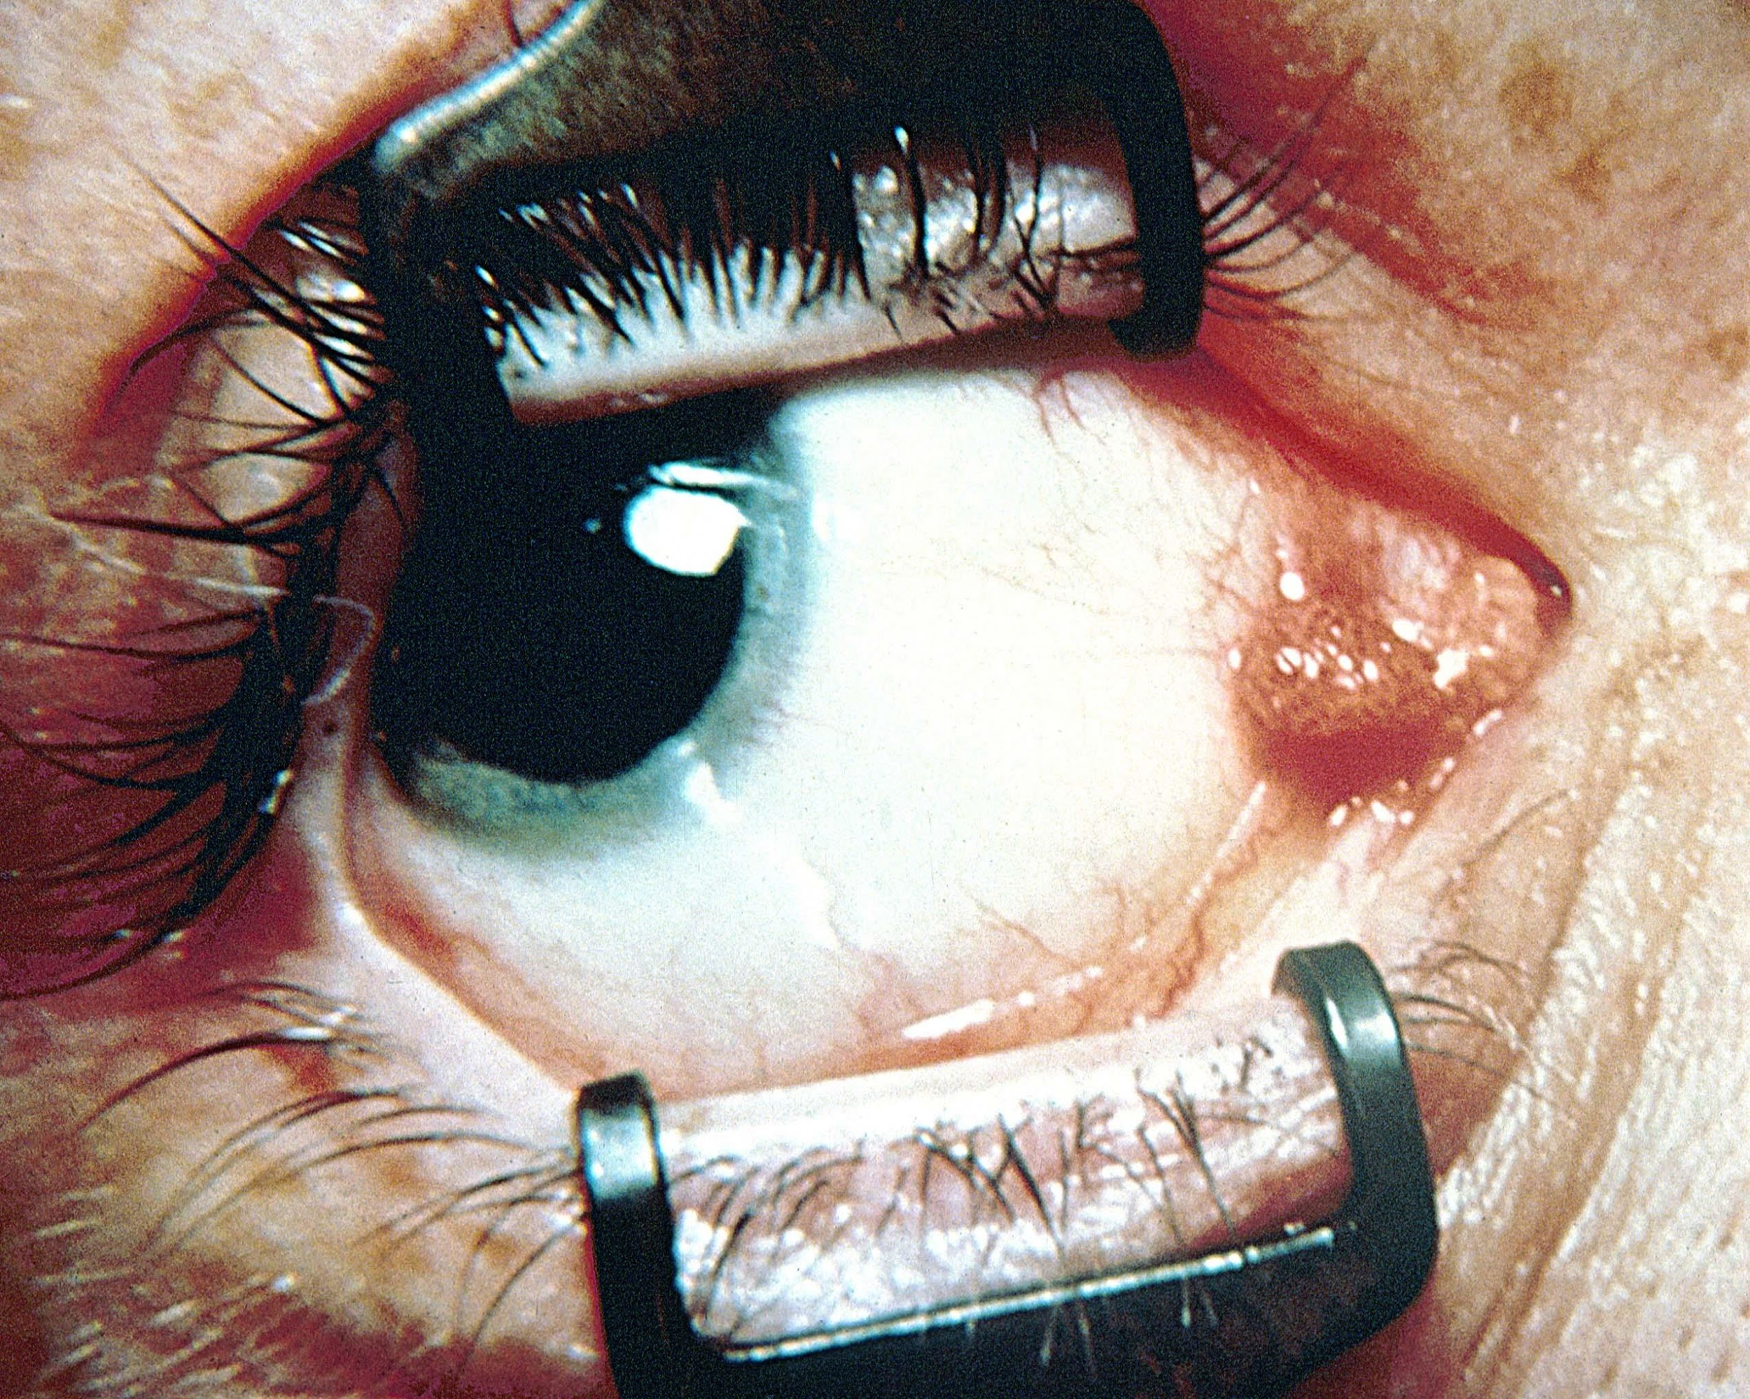

Slide 11
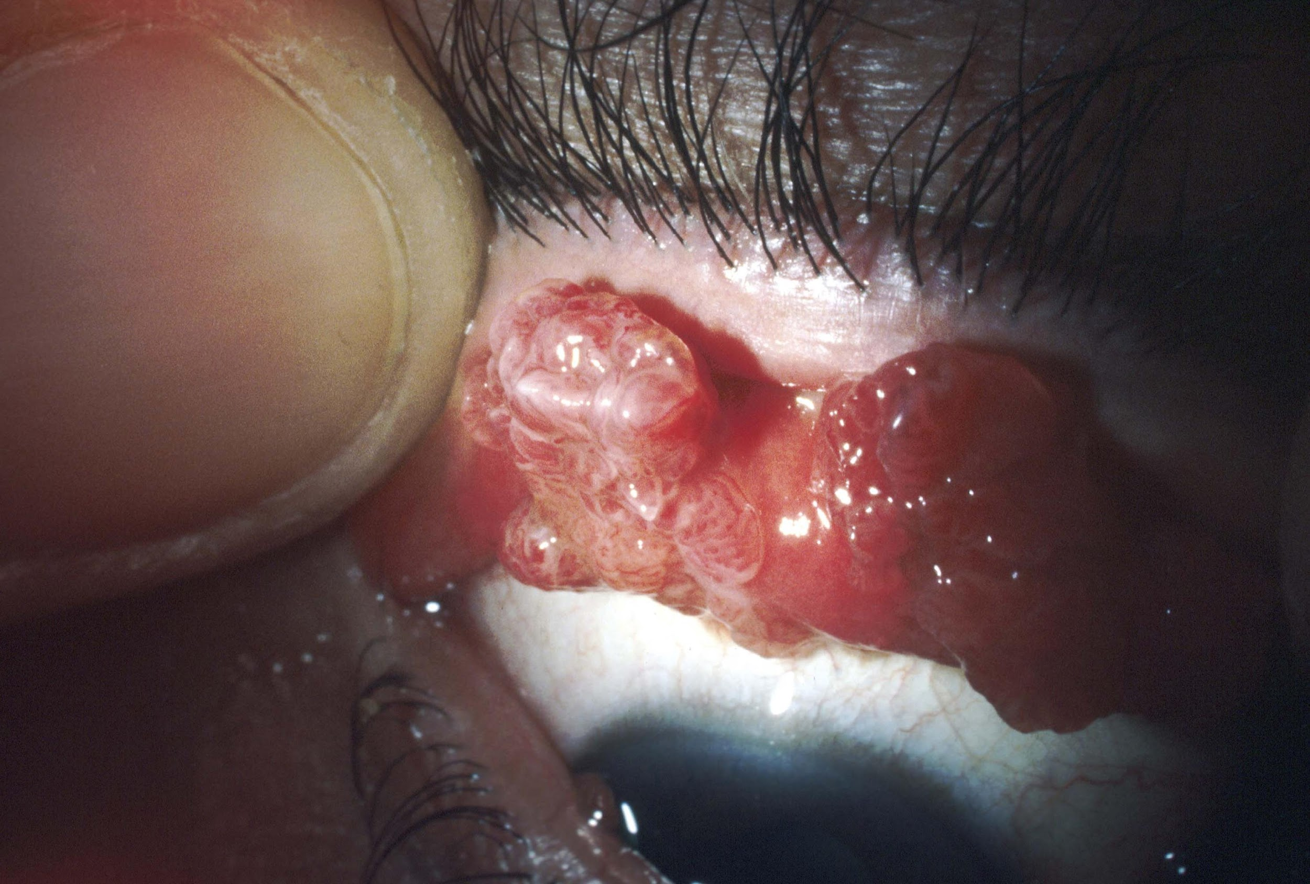

Slide 12
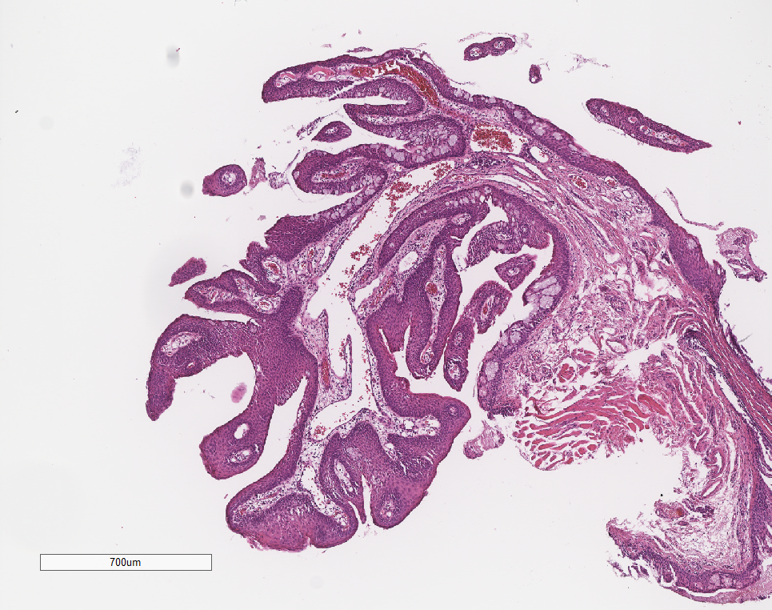

Slide 13
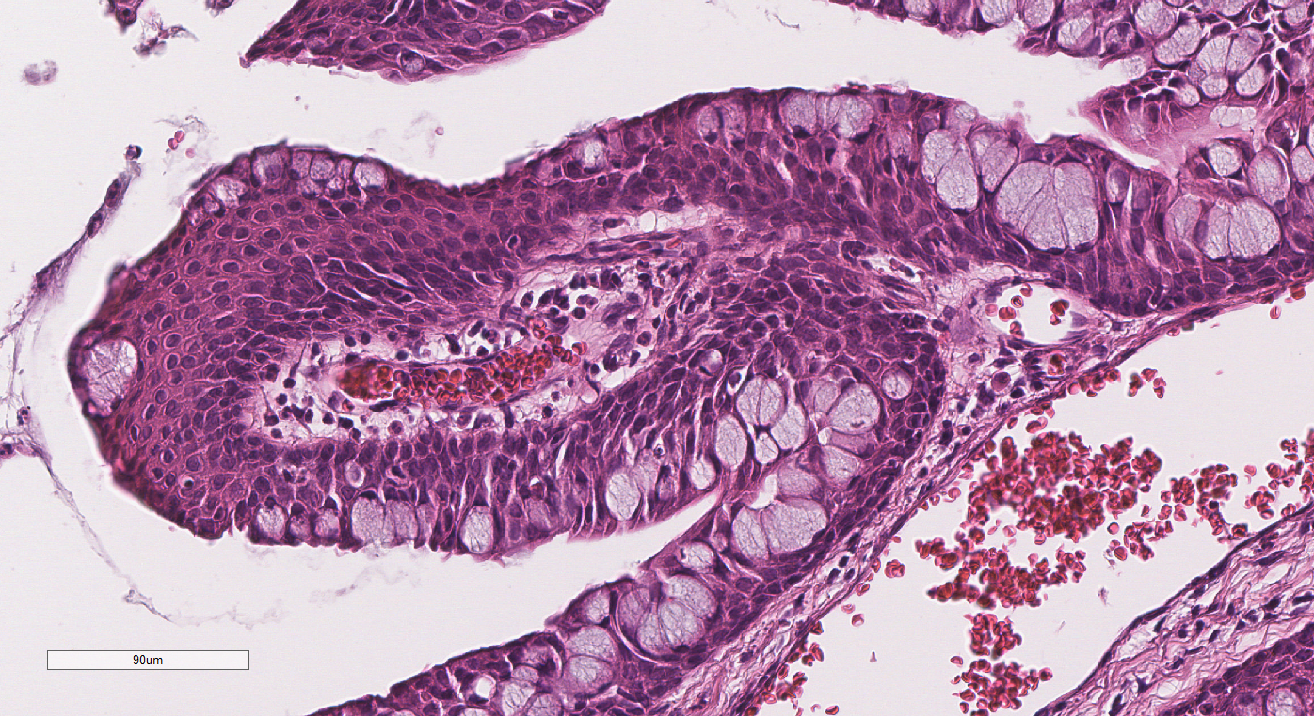

Slide 14
Differential diagnosis
Benign
Dysplastic/malignant
Pterygum/pinguecula
Squamous papilloma
Xerosis
Upper limbic keratoconjunctivitis
Keratoconjunctivitis sicca
Points of Bitot:
Deficiency of vitamin A
Conjunctival intraepithelial neoplasia
Squamous carcinoma
Adenosquamous carcinoma (Mucoepidermoid carcinoma)
Lymphoma
Fibrohistiocytic lesions

Slide 15
Conjunctival squamous intraepithelial neoplasia
More frequent conjunctival tumors
17 - 20 cases per million / year
Association with UV, immunosuppression, or autoimmunity.
testing in patients under 40 years of age?.

Slide 16
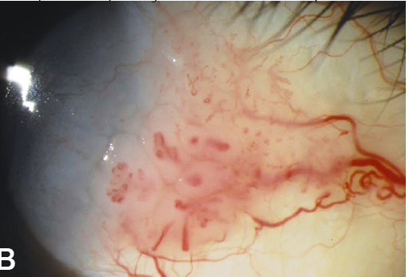

Slide 17
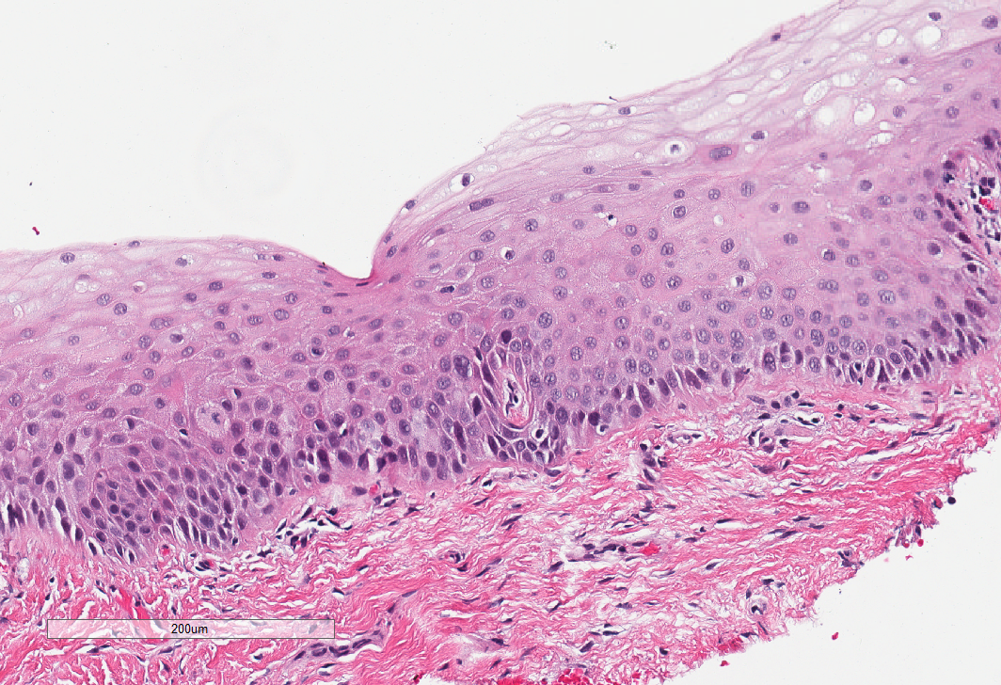
CIN I

Slide 18
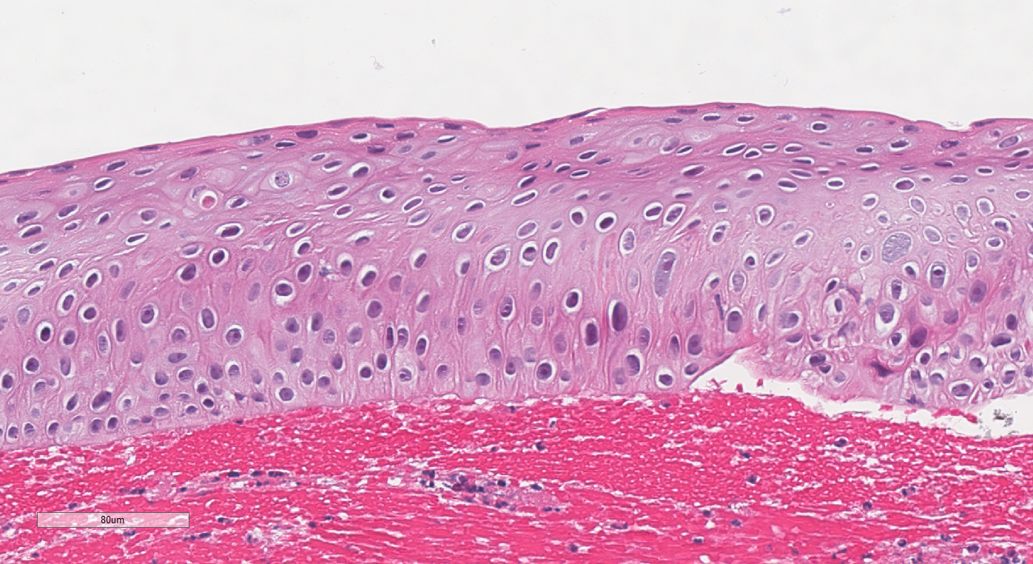
CIN I

Slide 19
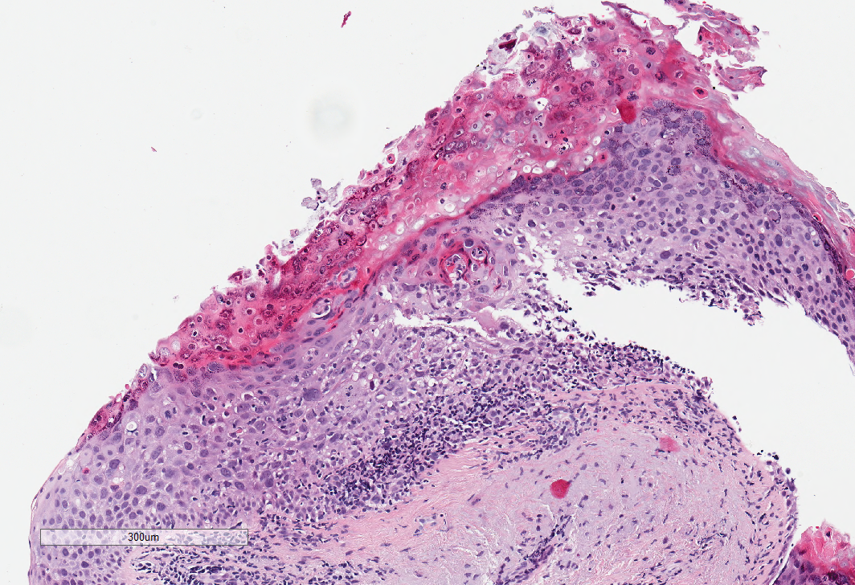
CIN II

Slide 20
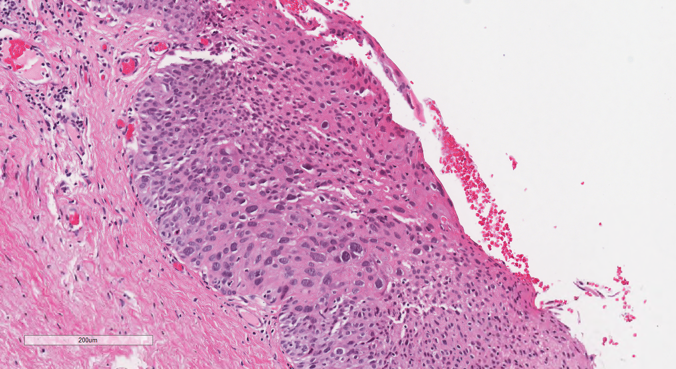
CIN III

Slide 21
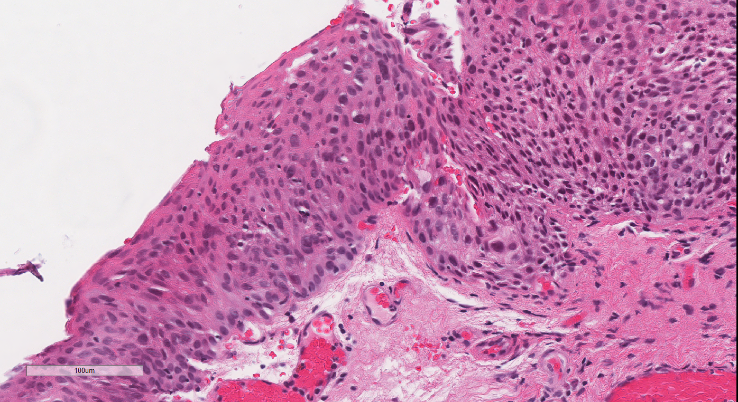
CIN III

Slide 22
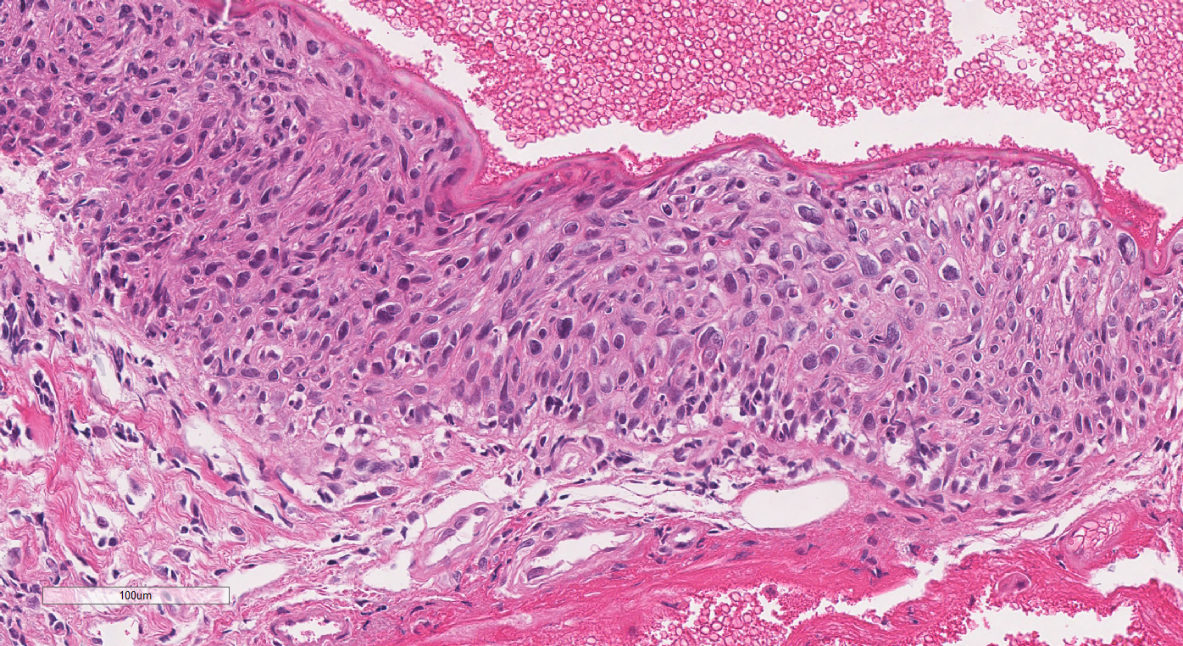
CIN III

Slide 23
Predictive factors of recurrence/progresion
Grade of differentiation.
Surgical margins.
Size (pTNM).
Local chemotherapy?
MMC, 5FU, INF

Slide 24
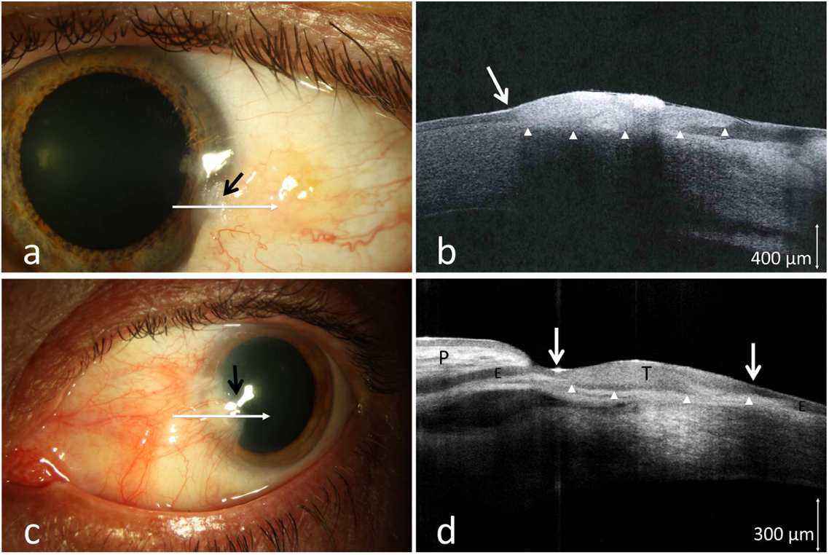

Slide 25
Differential diagnosis
Benignas
Dysplastic/malignant
Pterigion/pinguecula
Squamous papilloma
Xerosis
Upper limbic keratoconjunctivitis
Keratoconjunctivitis sicca
Points of Bitot:
Deficiency of vitamin A
Conjunctival intraepithelial neoplasia
Squamous carcinoma
Adenosquamous carcinoma (Mucoepidermoid carcinoma)
Lymphoma
Fibrohistiocytic lesions

Slide 26
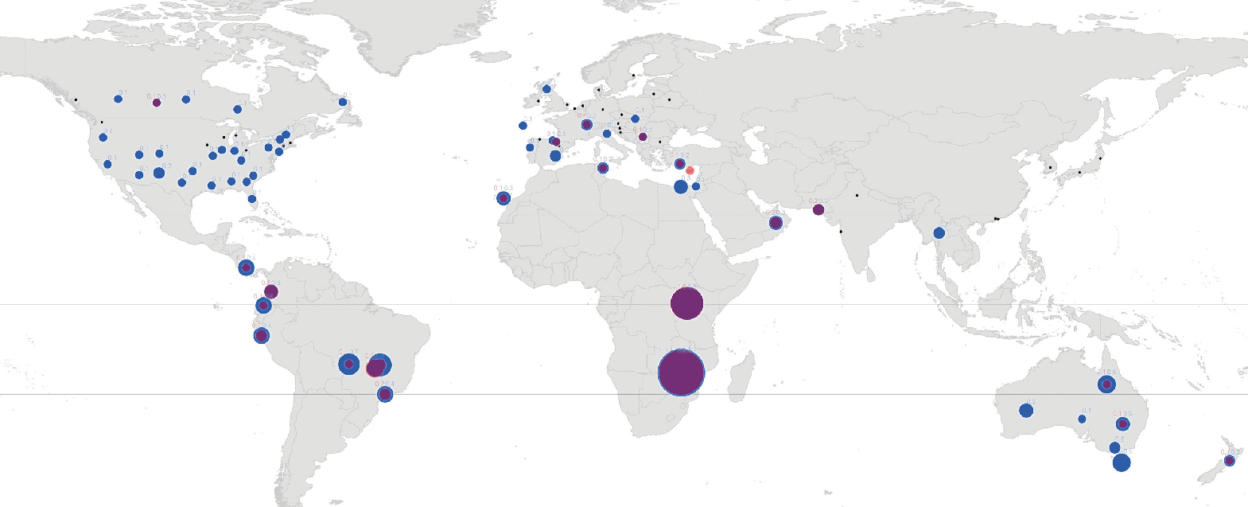
Squamous cell carcinoma
Incidence 0,18 per 100.000

Slide 27
Etiology and localization
UV radiation (dose response)
HPV (controversial)
Corneal limbus.

Slide 28
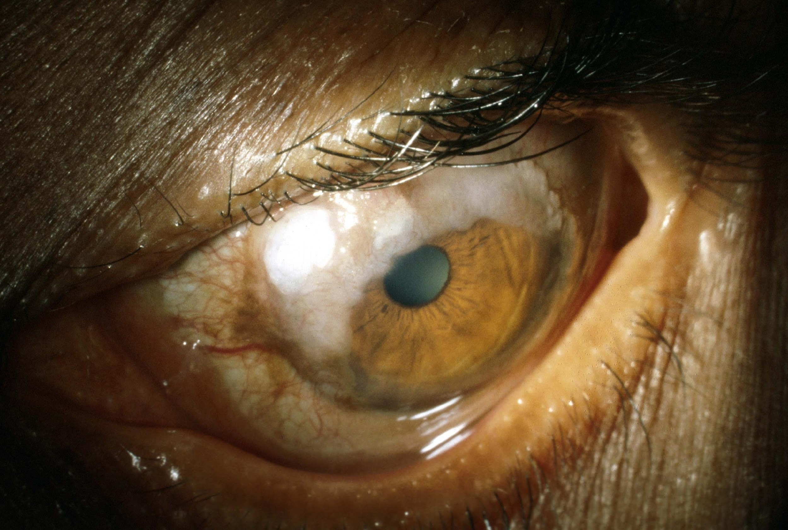

Slide 29
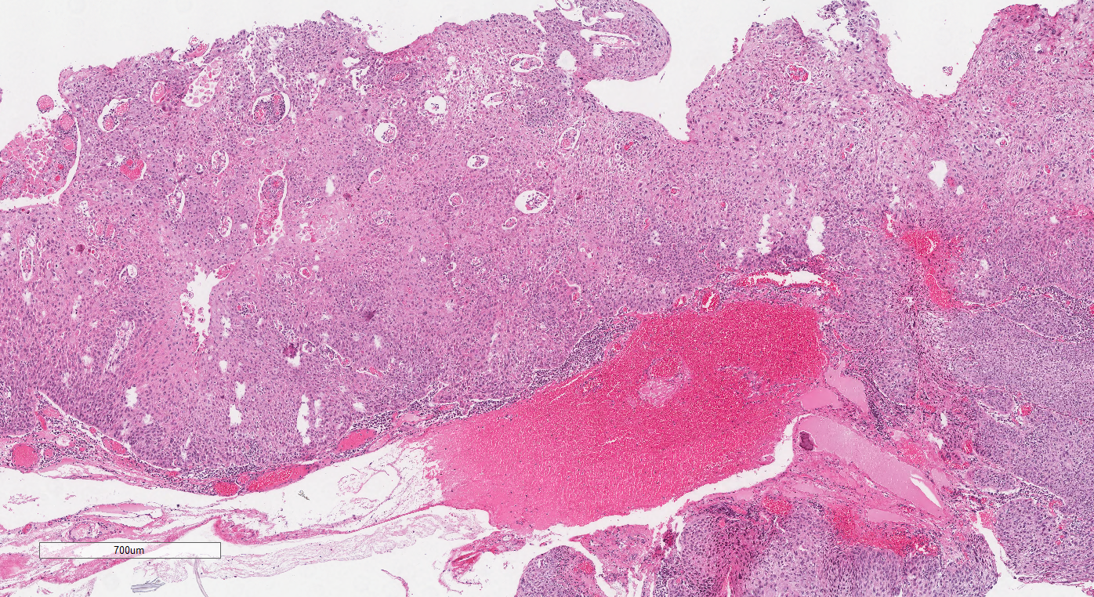

Slide 30
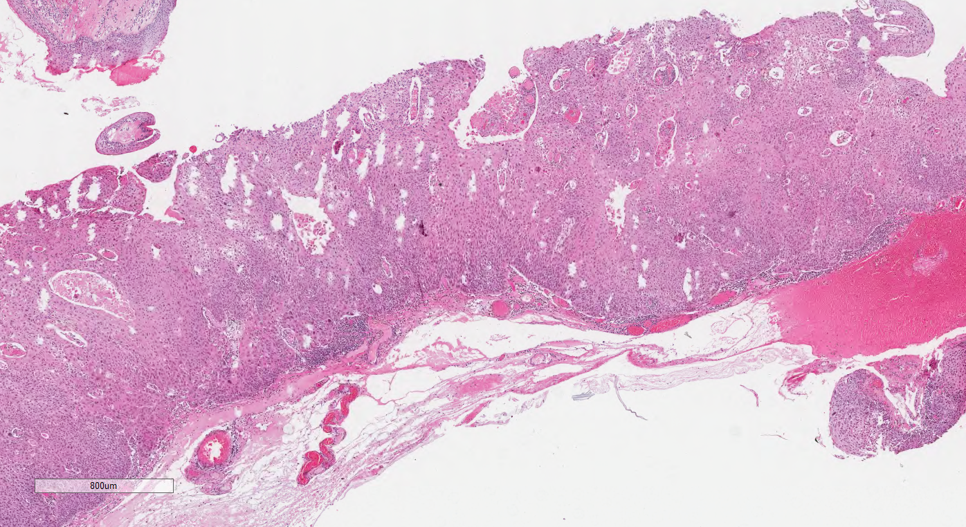

Slide 31
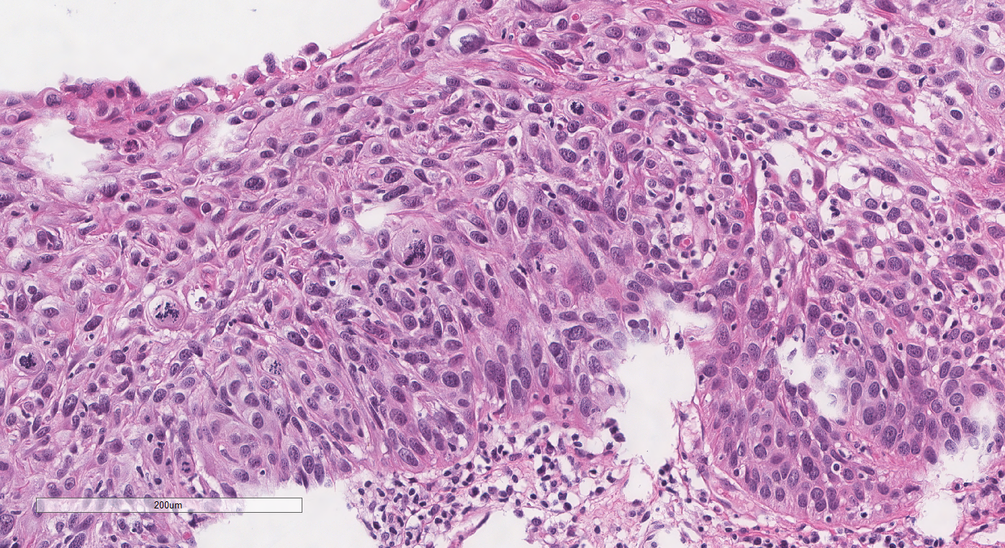

Slide 32
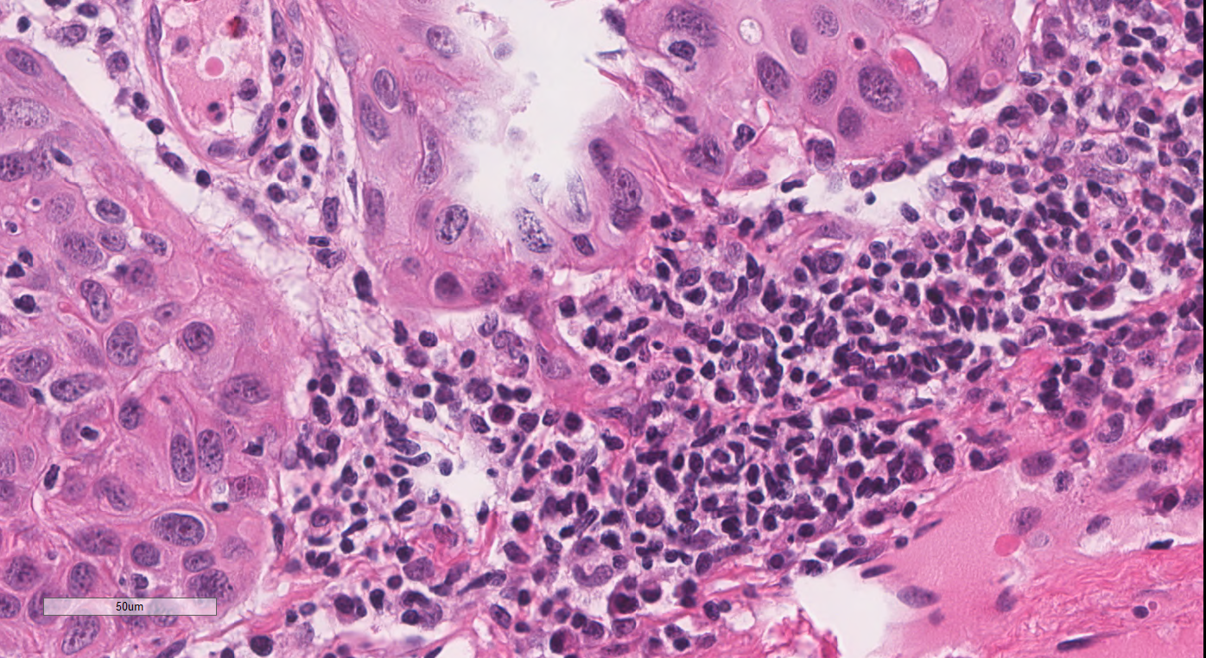

Slide 33
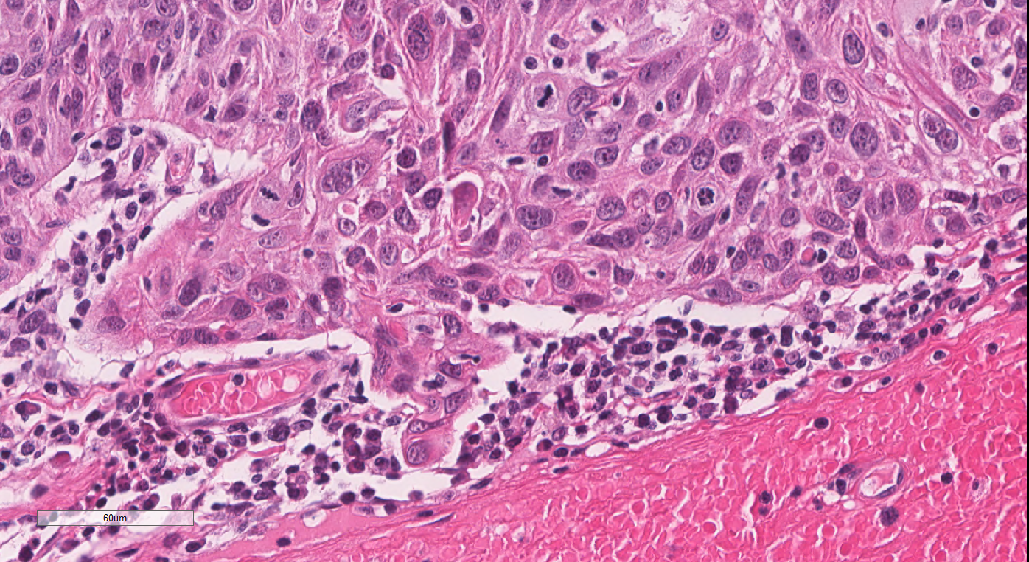

Slide 34
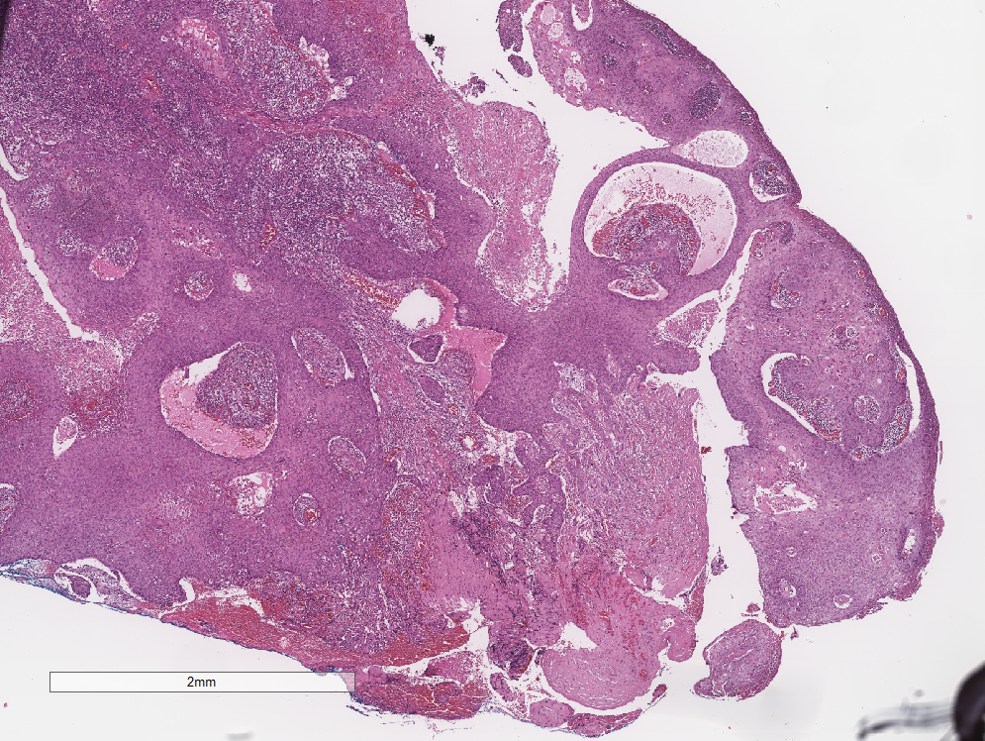

Slide 35
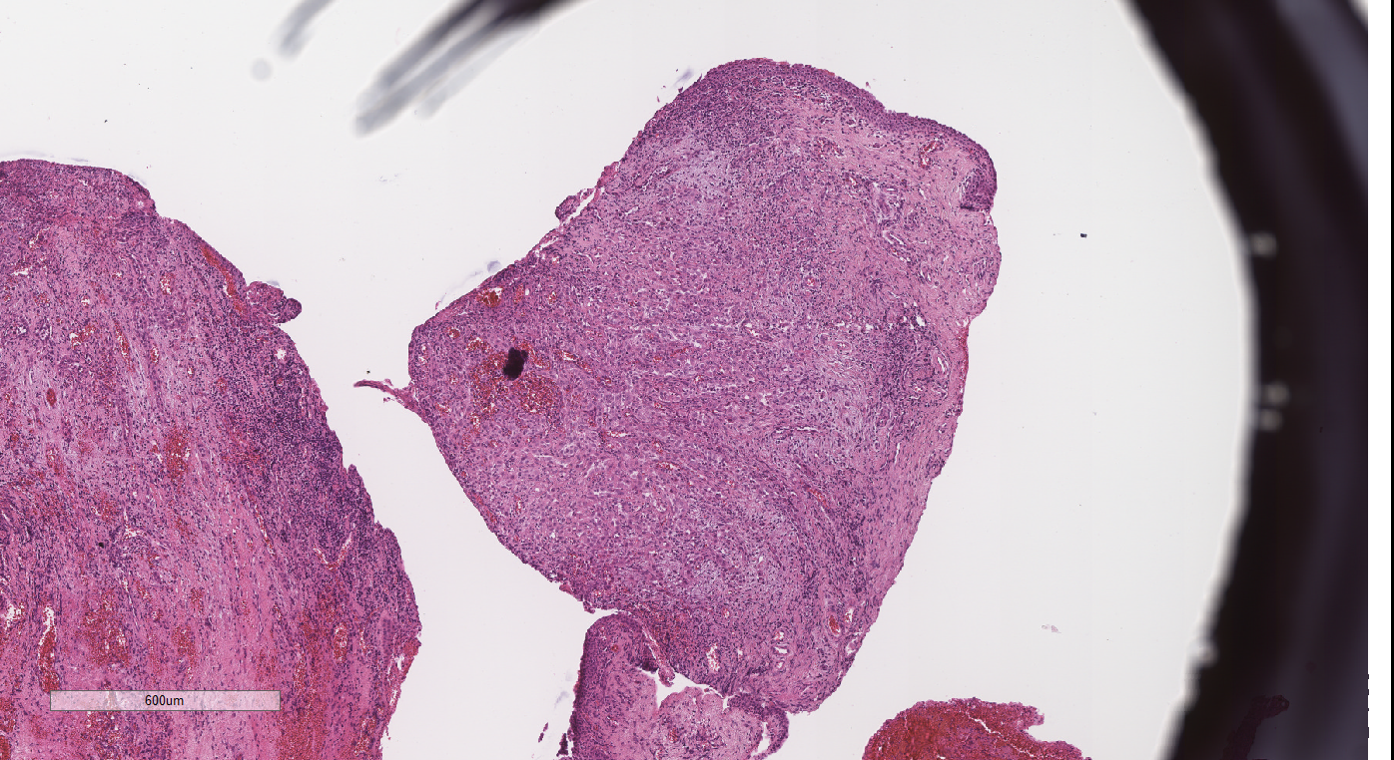

Slide 36
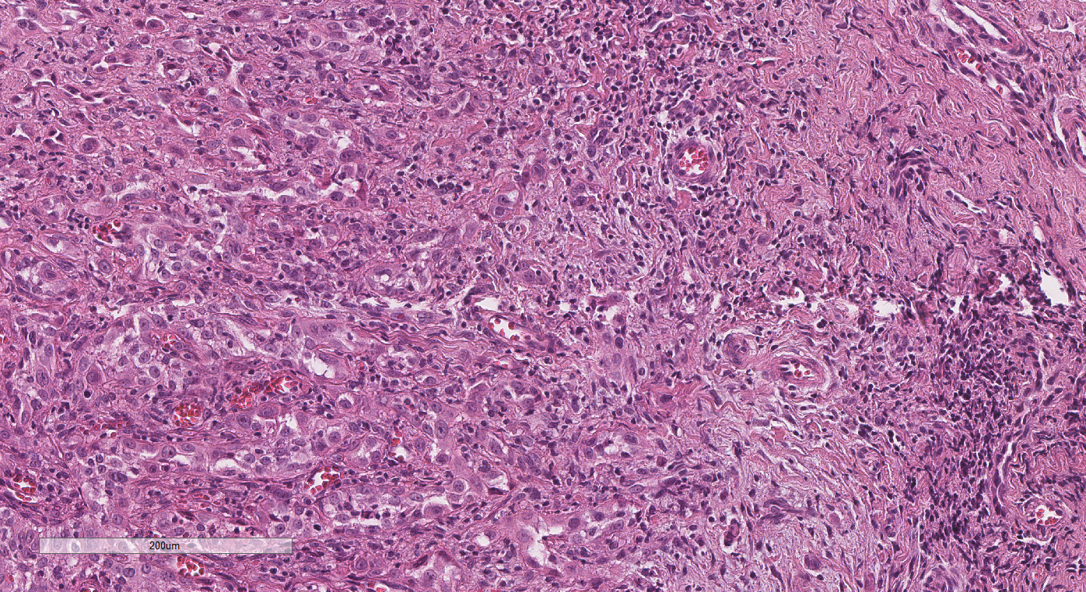

Slide 37
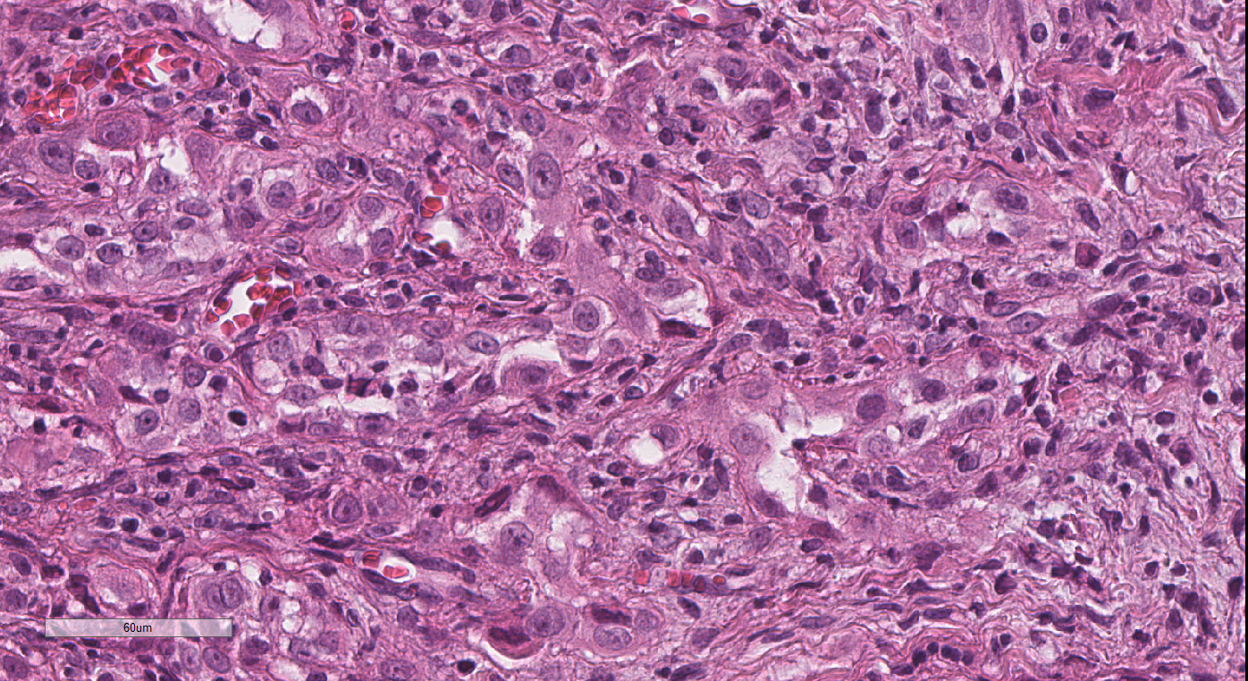

Slide 38
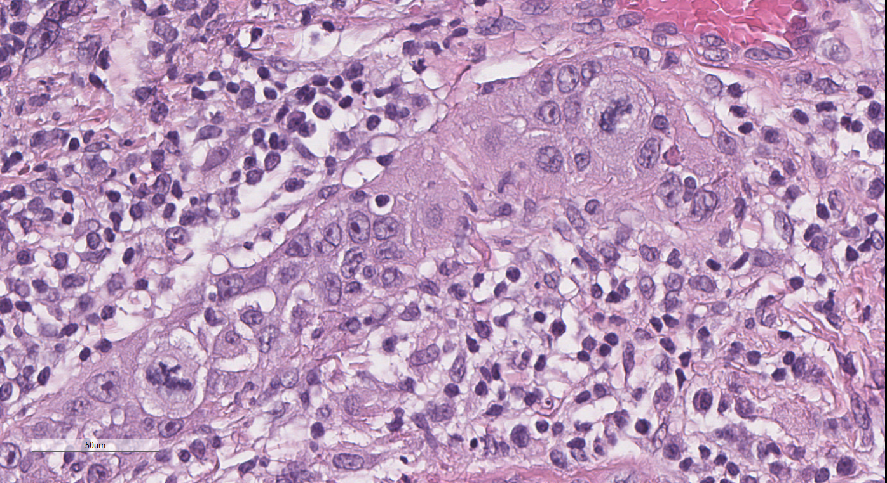

Slide 39
Ancilliary studies
P40 for poorly differentiated cases
Sebaceous cell carcinoma (Adipophilin, CK7)
Merkel (CK20+)
Melanoma (Triple melanoma (HMB45, MELAN A and tyrosinase) or SOX10)
Spindle cell carcinoma
Melanoma (Pan melanoma or SOX10)
Sarcomas (vimentin + (Desmin, H-Caldesmon, S100, EMA, CD10, BCL-2...))

Slide 40
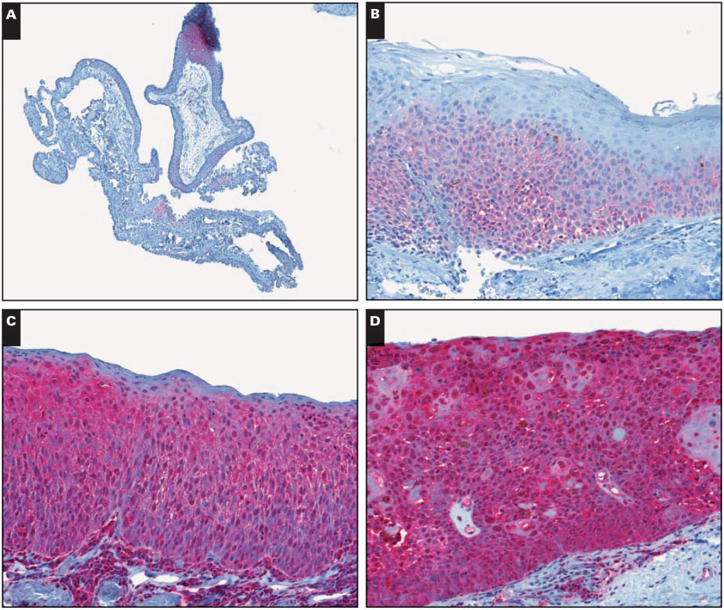
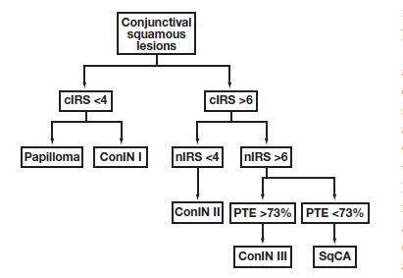

Slide 41
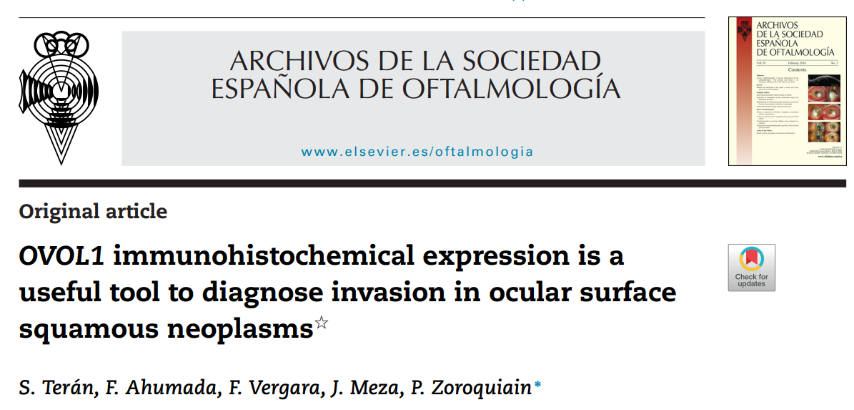
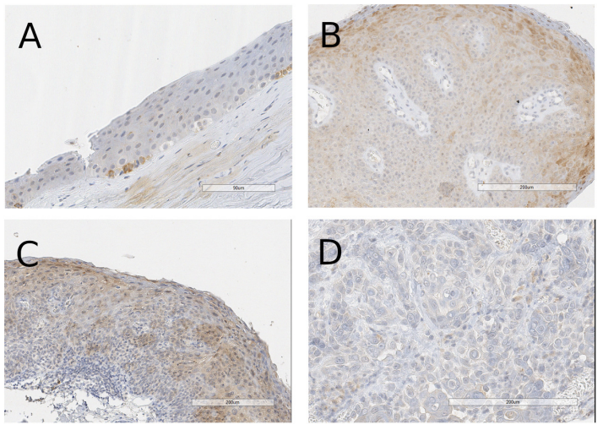
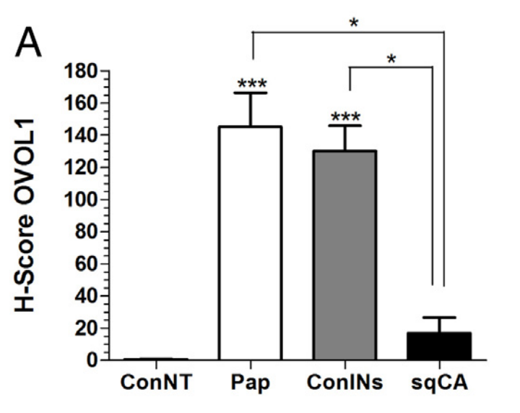

Slide 42
Prognostic factors in conjunctival carcinoma
Depth of stromal Infiltration.
Tumor size
Invasion of neighboring structures
Surgical margins
Vascular and perineural invasion
Nodal involvement
Distant metastasis

Slide 43
Papel dos estudos citológicos na superfície do olho

Slide 44
Impression cytology

Slide 45
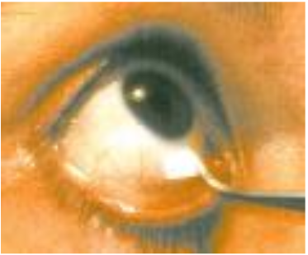
Introduction
Aplication of acetate filter paper on the ocular surface.

Slide 46
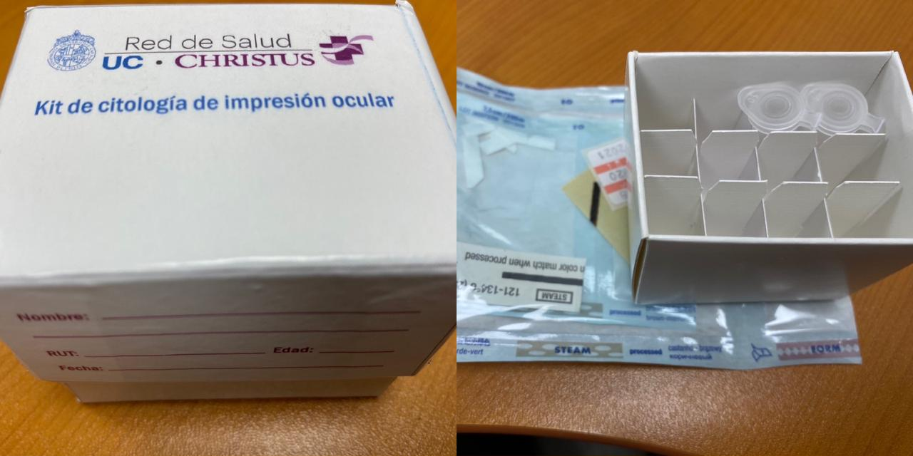

Slide 47
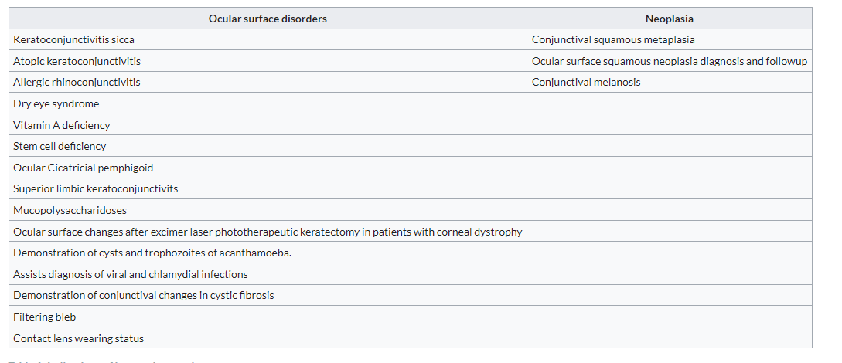
Dogru Met al. Impression cytology in atopic dermatitis Ophthalmology. 1998 105(8)

Slide 48
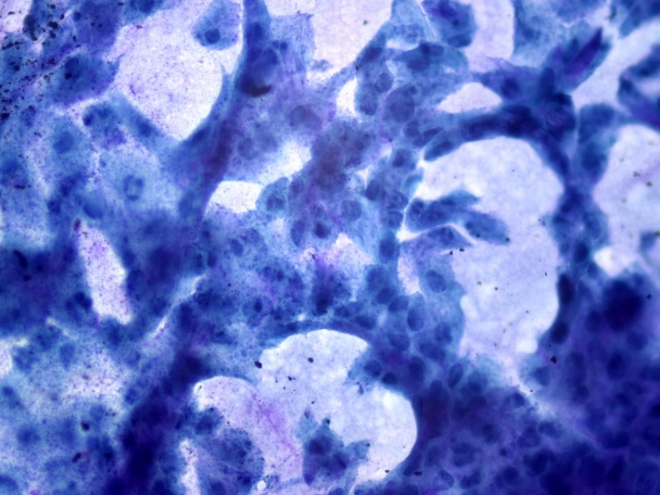
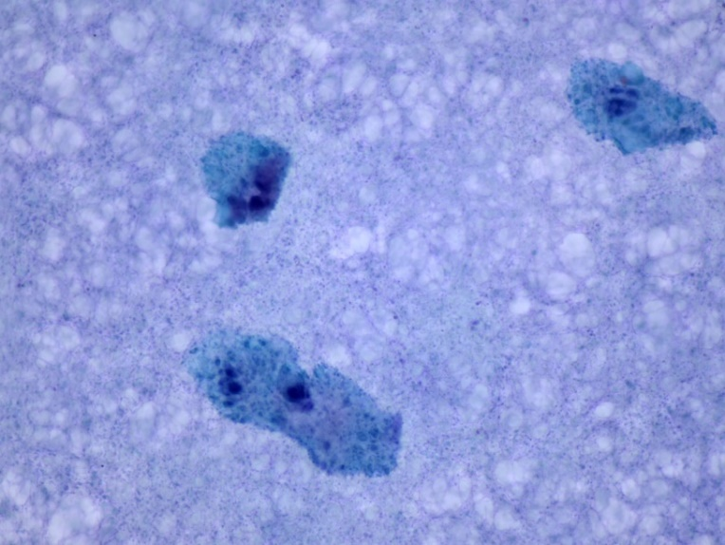
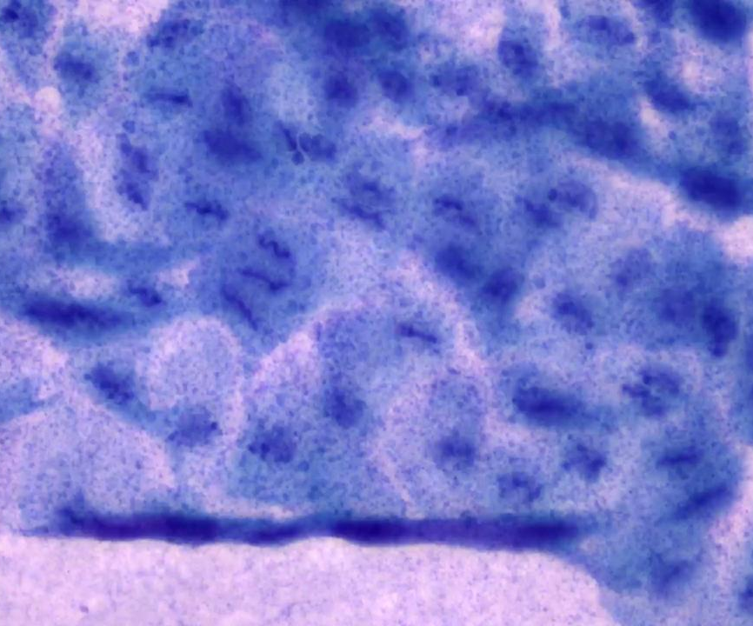

Slide 49
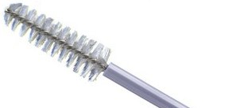
Cytobrush cytology

Slide 50
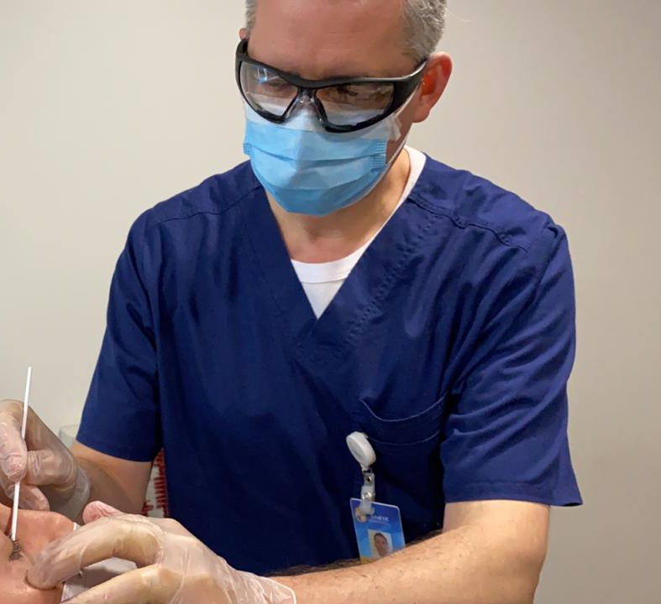
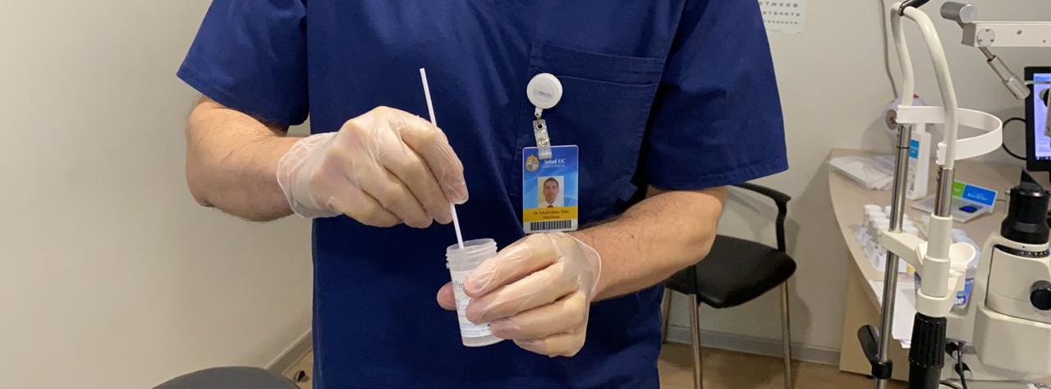

Slide 51
Dry eye disease

Slide 52
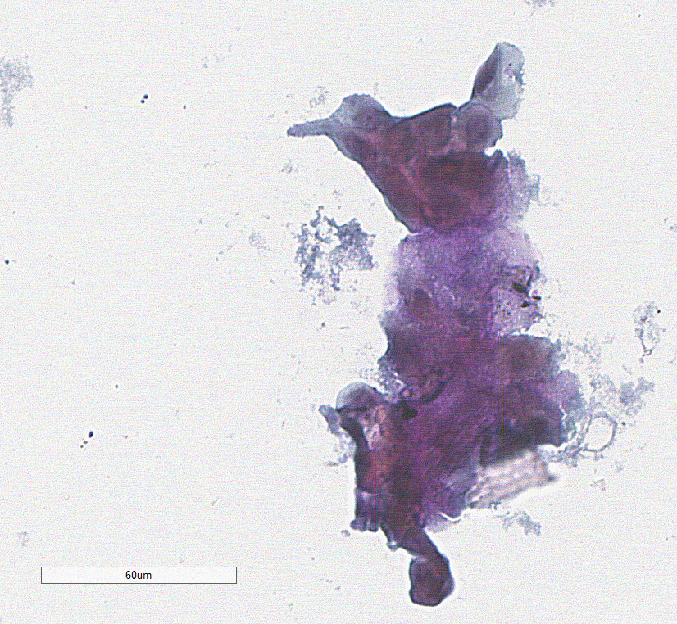

Slide 53
Neoplasias

Slide 54
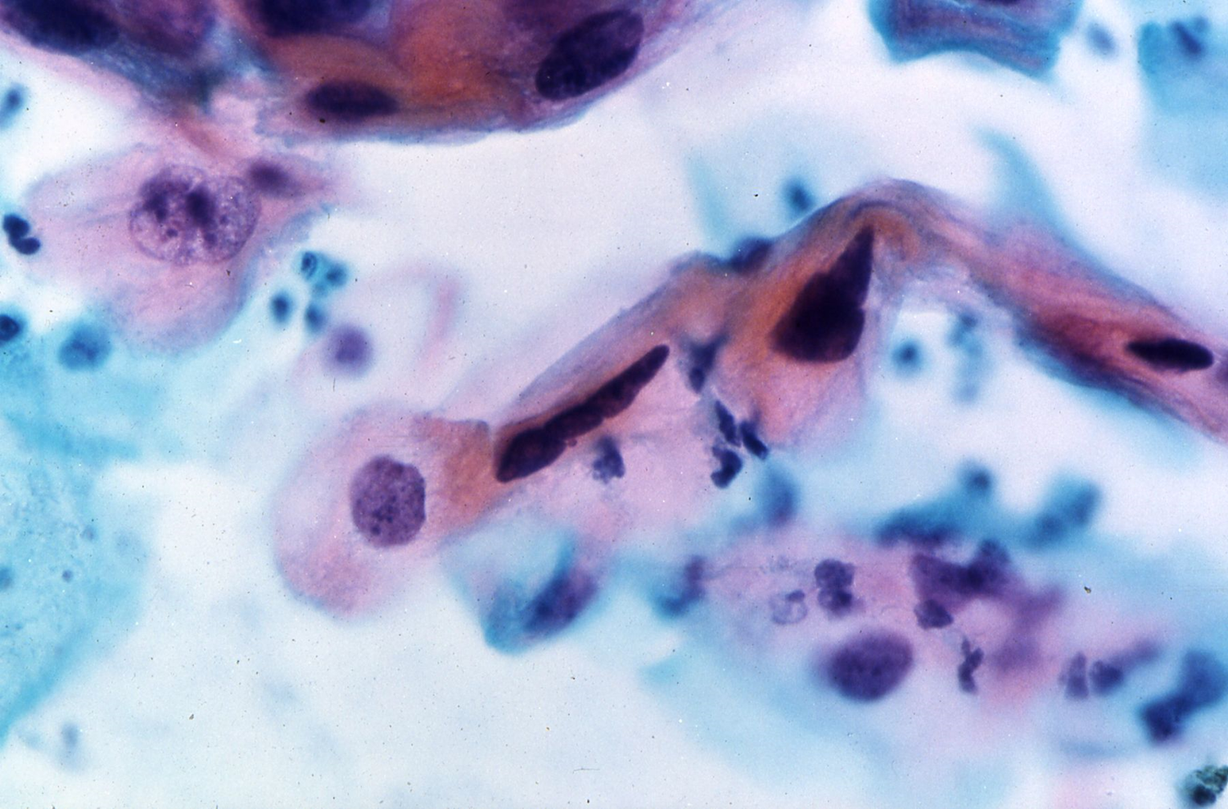

Slide 55
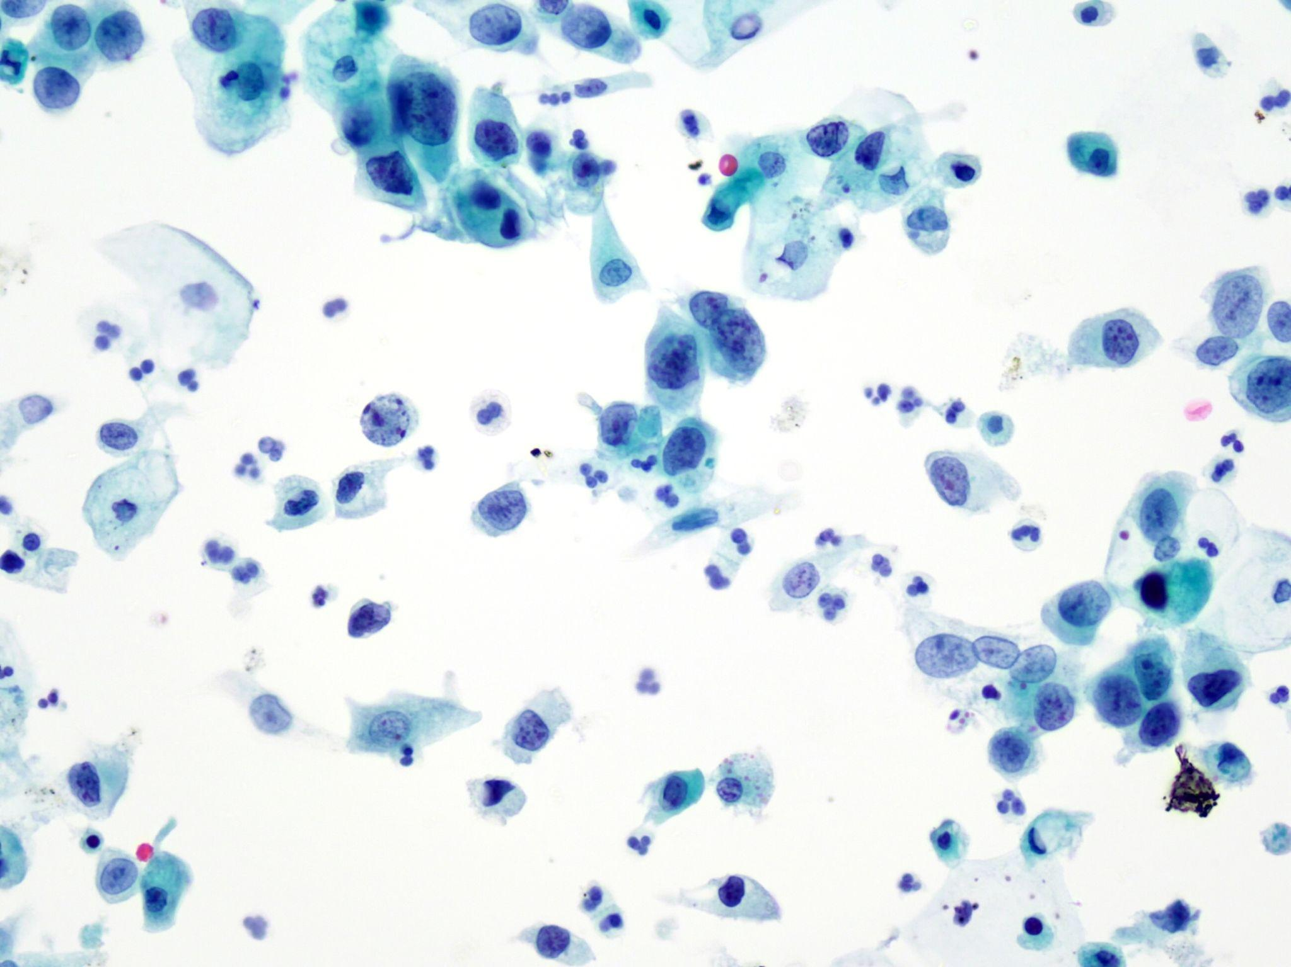

Slide 56
Surface cytology
Advantages
Limitations
It allows the diagnosis of surface lesions.
ICC, MP, etc.
Easy to obtain and non-invasive.
Many samples can be obtained from a single procedure.
It requires a paralel workflow.
It is not widely use.
It does not differentiate invasion from in situ.
Impression: limited ancilliary studies.

Slide 57
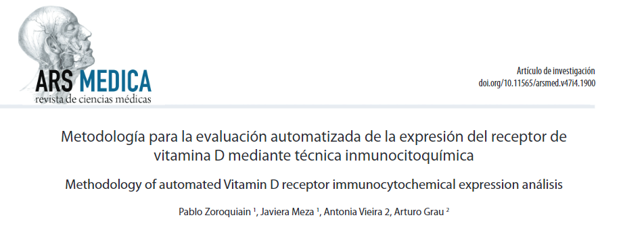
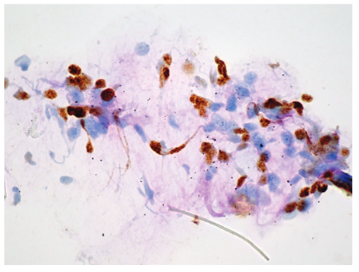
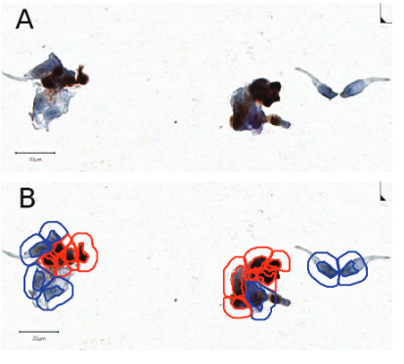

Slide 58
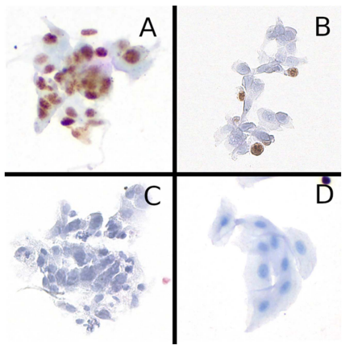
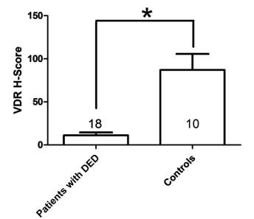
In press 2024

Slide 59
Take Home Messages
Differential diagnosis includes benign, premalignant, and malignant lesions.
Neoplastic lesions are strongly associated with UV light.
It is important to report prognostic morphological features and pTNM.
Cytology of the surface is useful for the diagnosis of medical and tumoral conditions.

Slide 60
Obrigado!
zoroquiain@gmail.com

